Slide 1
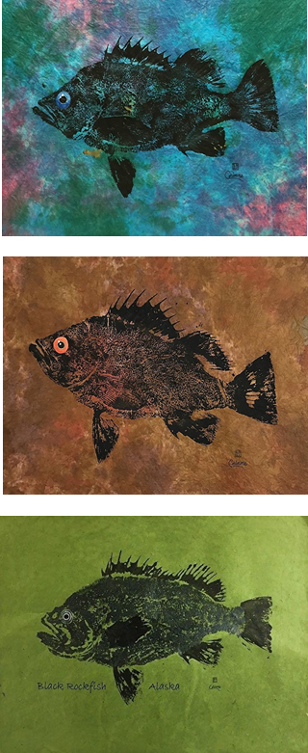
Accounting for population dynamics improves the use of no-take marine reserves for fishery management
Victoria Quennessen
MS Student in Fisheries Science
Hotel Coral y Marina, Ensenada, Mexico
Western Society of Naturalists
November 2nd, 2019

Slide 2
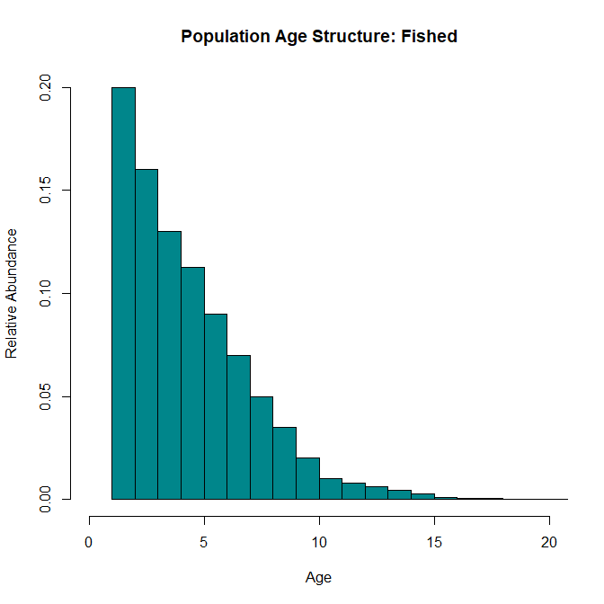
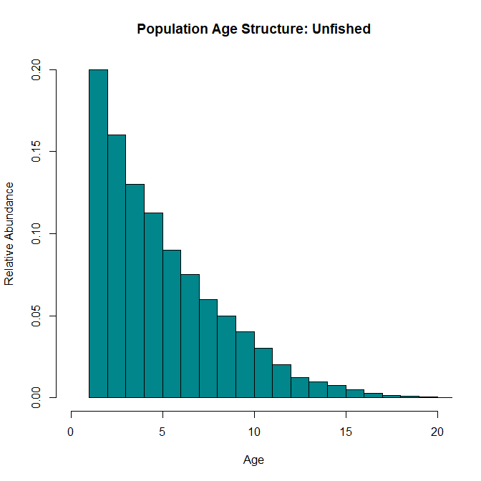
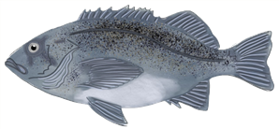
Effects of Fishing
Background
Methods
Results
Next Steps
Question
Conclusions
Bigger, older individuals
Notes:
Effects of fishing:
Truncation of age structure
Decreased biomass and abundance
Increased vulnerability to fishing

Slide 3
Effects of Fishing
Background
Methods
Results
Next Steps
Question
Conclusions
Bigger, older individuals
Notes:
Effects of fishing:
Truncation of age structure
Decreased biomass and abundance
Increased vulnerability to fishing
Growing emphasis on use of marine protected areas (MPAs) to protect fisheries and reduce effects of fishing pressure
149 studies on 124 MPAs in 29 countries
As of 2015, 3.5% of world’s oceans in MPAs, about 1.6% strongly or fully protected (Lubchenco and Grorud-Colvert, 2015)

Slide 4
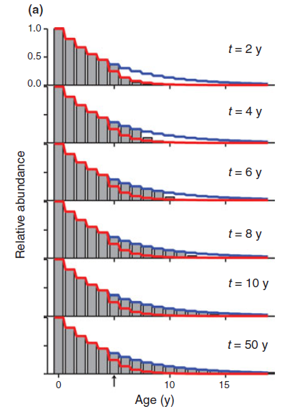
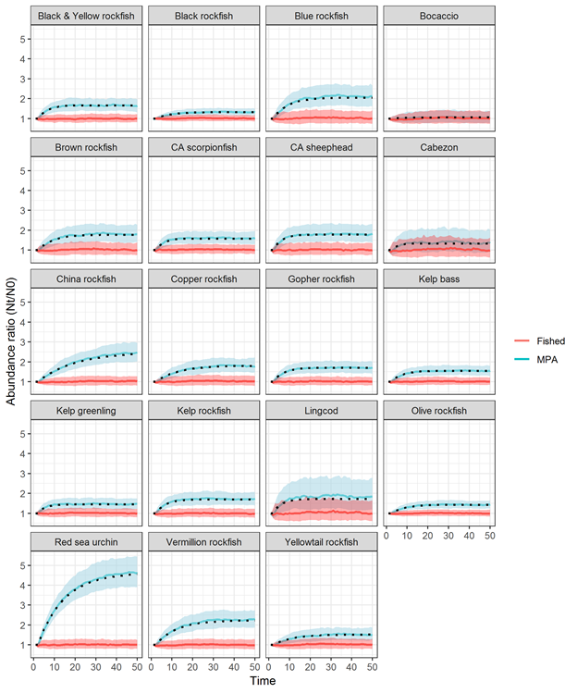
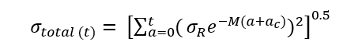
Background
Methods
Results
Next Steps
Question
Conclusions
Transient Dynamics and Stochasticity
Abundance Ratio (N_{t}/N₀)
Fished
MPA
Time (years)
Adapted from Kaplan et al. 2019
White et al., 2013
Kaplan et al. 2019
Notes:
After protections, age structure fills back in over time (red line = fished, blue = unfished)
Standard deviation of population trajectory equation
Open population dynamics with stochastic recruitment
The rate at which the age structure fills in and biomass increases depends on the species’ natural mortality rate, von Bertalanffy growth rate, variability in recruitment, and the age at entry into the fishery (Kaplan et al. in review; White et al. 2013).

Slide 5
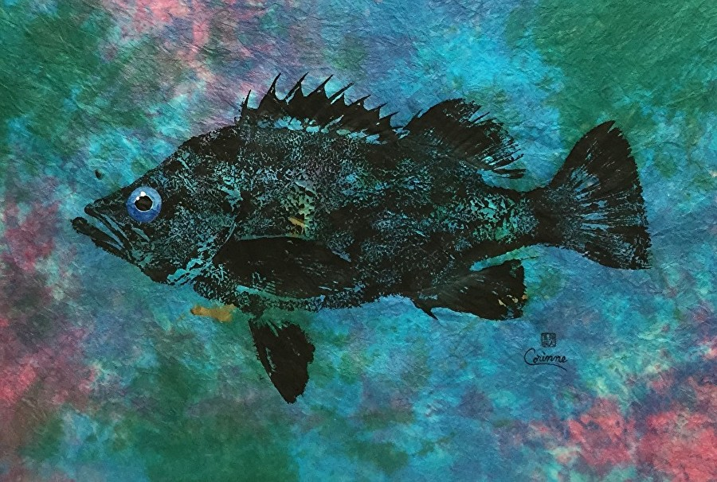
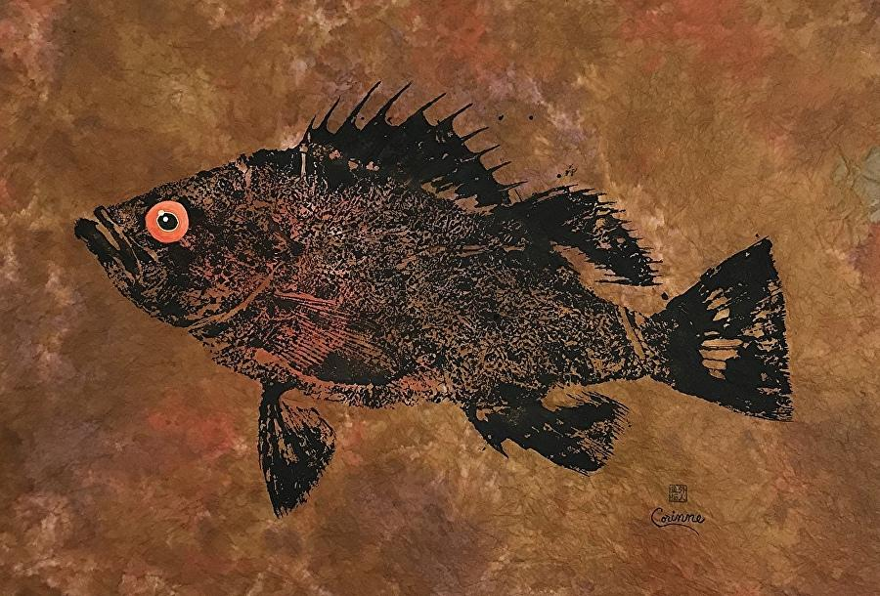
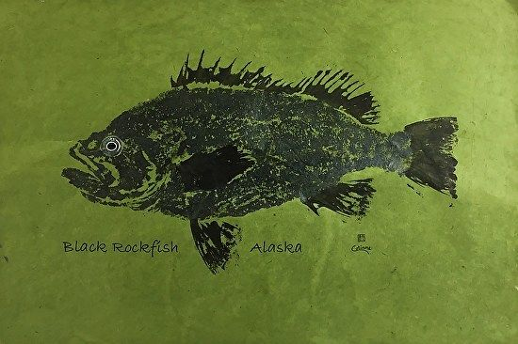
Background
Methods
Results
Next Steps
Question
Conclusions
Objectives / research questions
How can we best use information from within reserves to help manage fisheries following reserve implementation?
How does the inclusion of transient dynamics affect the effectiveness of control rules?
How

Slide 6
1. Replicate base model
Background
Methods
Results
Next Steps
Question
Conclusions
Population dynamics
Imperfect sampling
Current west coast groundfish fishery has 40:10 control rule
Density ratio as metric to assess level of depletion:
# ind./ area outside reserve
-------------------------------------
# ind./ area inside reserve
Management (control rules)
Fishing
Adapted from Babcock & MacCall 2011
Notes:
Fishing effort is reduced for stocks below a certain threshold (B40%, or 40% of unfished biomass) until it hits B10%, after which the fishery is closed completely

Slide 7
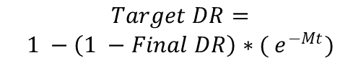
2. Apply transient dynamics to control rules
Background
Methods
Results
Next Steps
Question
Conclusions
CR | 1 | 2 | 3 | 4 | 5
Type | DR | Effort | DR | DR | DR
Floor DR | 0.2 | NA | 0.2 | 0.2 | 0.2
Target DR | 0.6 | NA | Transient Low M Final 0.6 | Transient Correct M Final 0.6 | Transient High M Final 0.6
Effort Increase | 0.1 | 0.1 | 0.1 | 0.1 | 0.1
Years Sampled | 1 | NA | 1 | 1 | 1
Areas Sampled | All | NA | All | All | All
Fish Sampled | Mature | NA | All | All | All
$$Target DR=$$
$$1 −\left(1 −Final DR\right)∗( e^{−Mt})$$
Adapted from White et al. 2013
Notes:
Fishing effort is reduced for stocks below a certain threshold (B40%, or 40% of unfished biomass) until it hits B10%, after which the fishery is closed completely

Slide 8
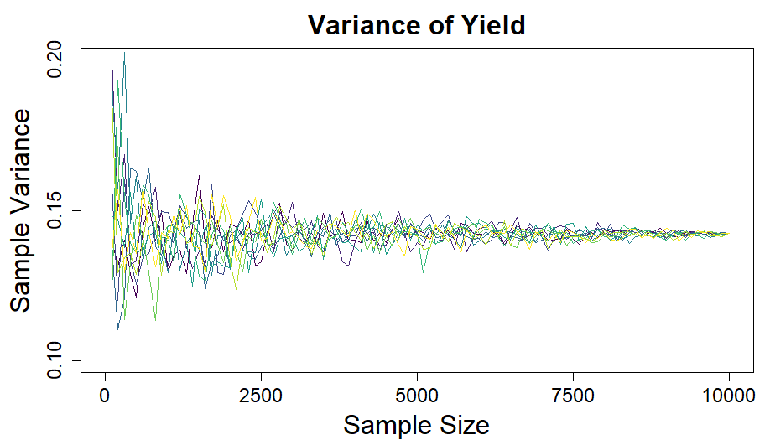
Variance vs. sample size
Background
Methods
Results
Next Steps
Question
Conclusions
Notes:
Define M and k

Slide 9
Transient dynamics
Background
Methods
Results
Next Steps
Question
Conclusions
P
Notes:
Define M and k

Slide 10

Next steps:
Background
Methods
Results
Next Steps
Question
Conclusions
Apply process to different species
Quantify effect of uncertainty about mortality on control rule success
Partner with ODFW to prep for 2023 OR marine reserve assessment
Notes:
Define M and k

Slide 11
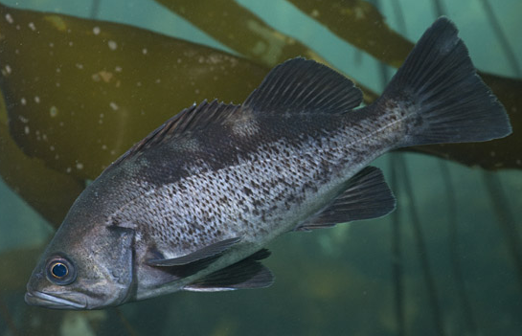
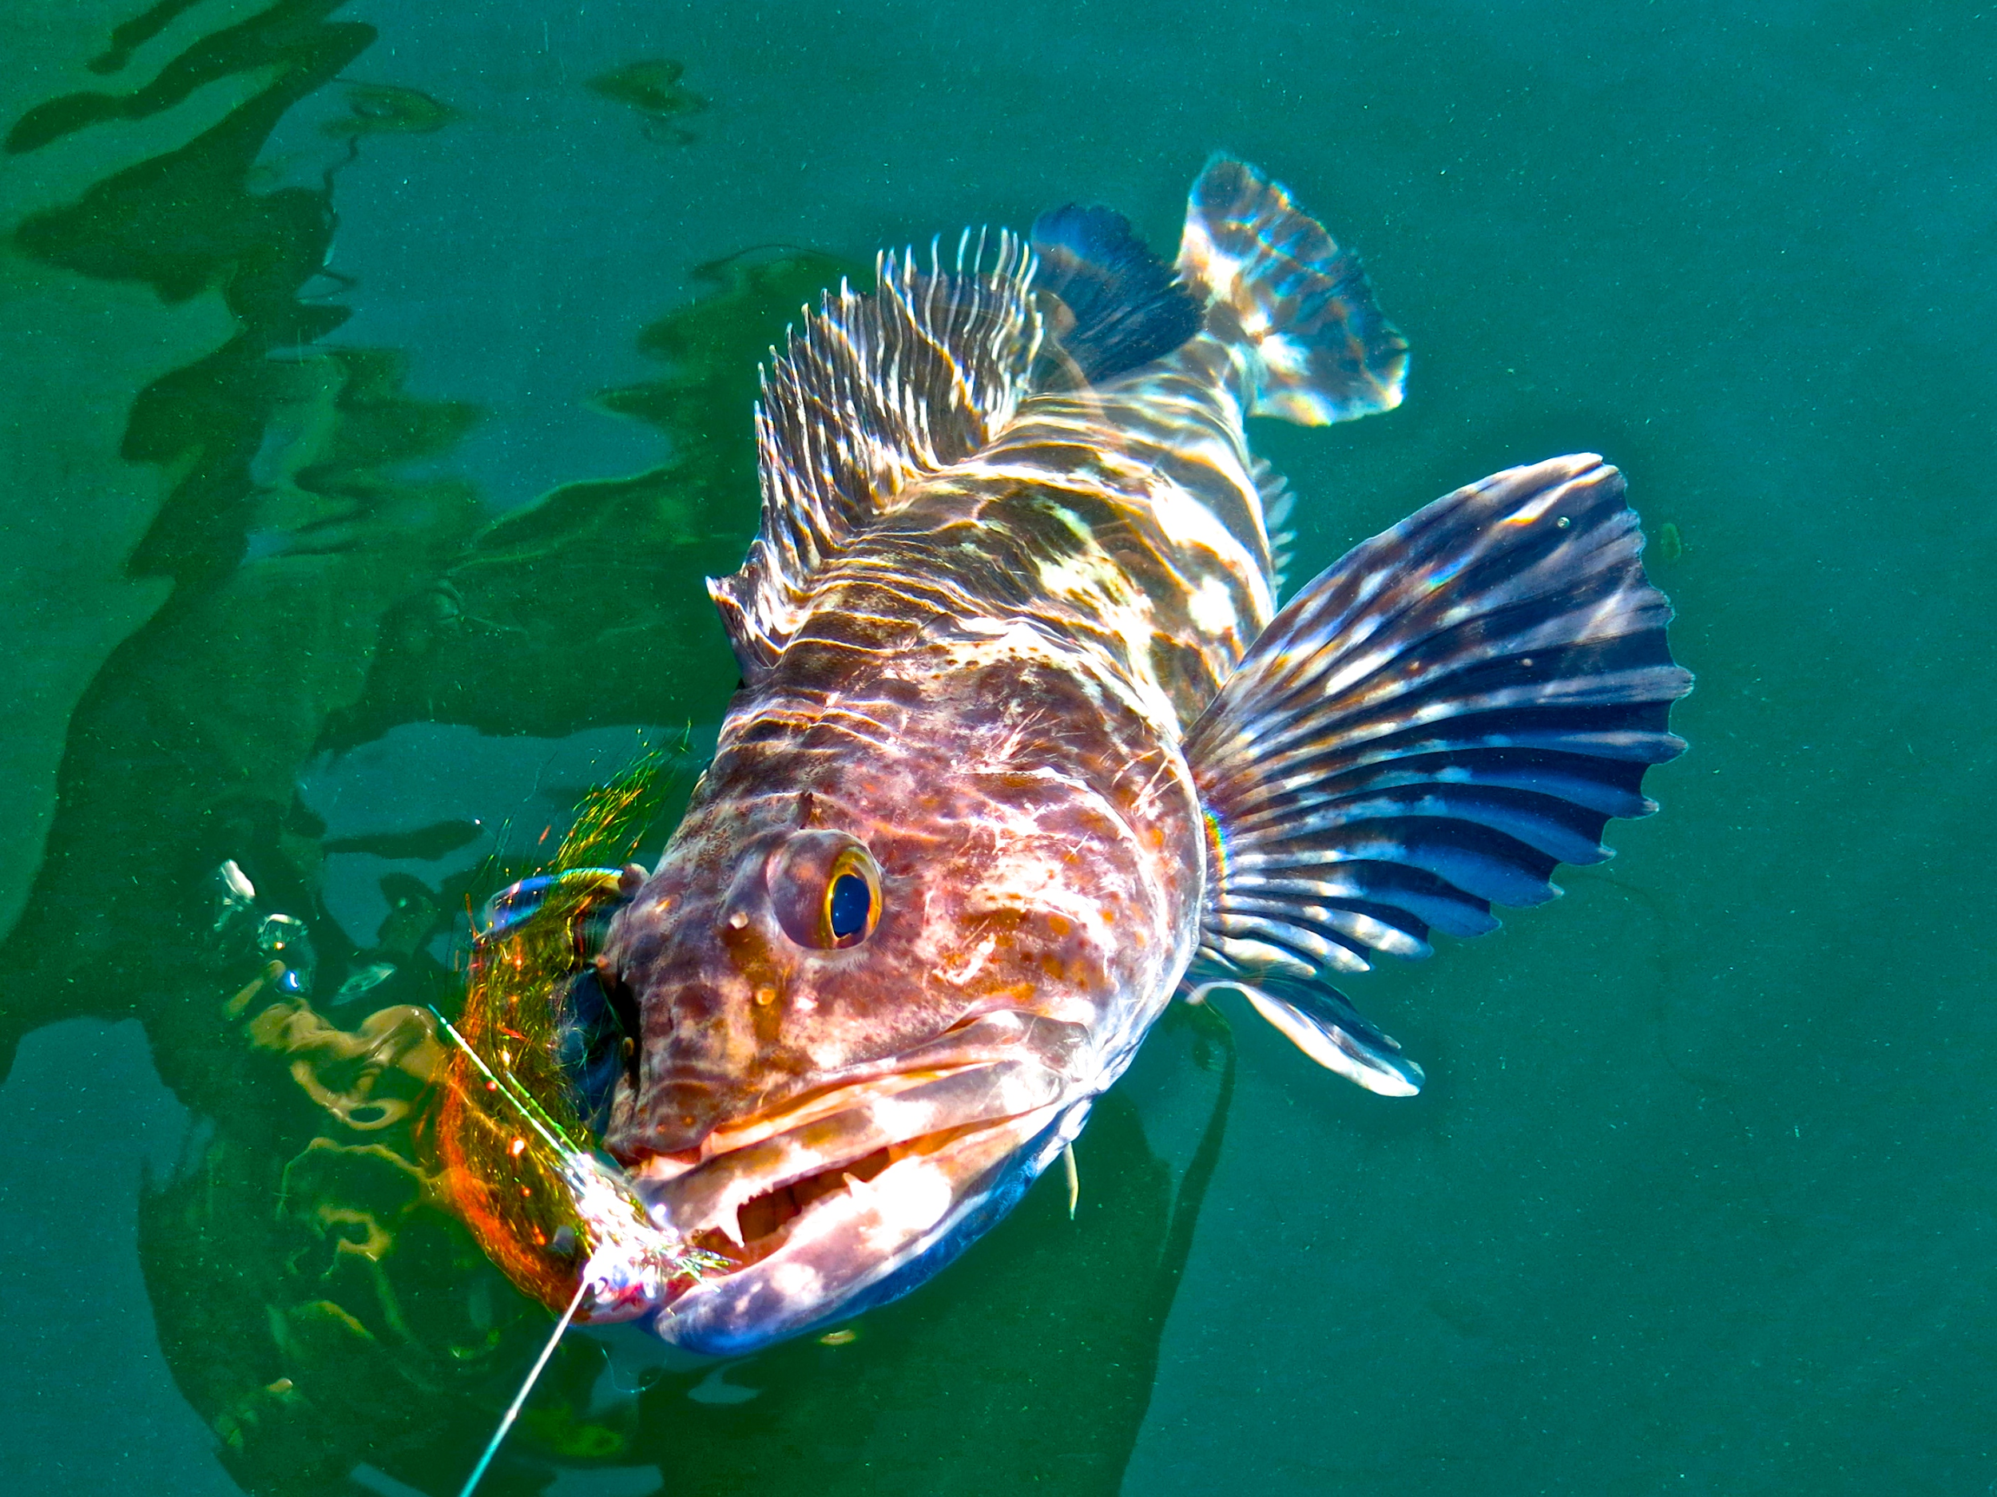
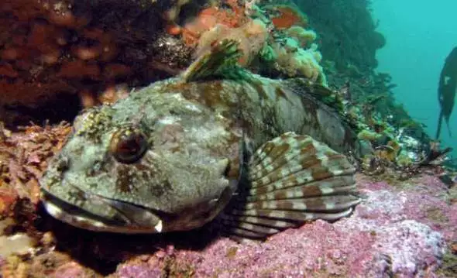
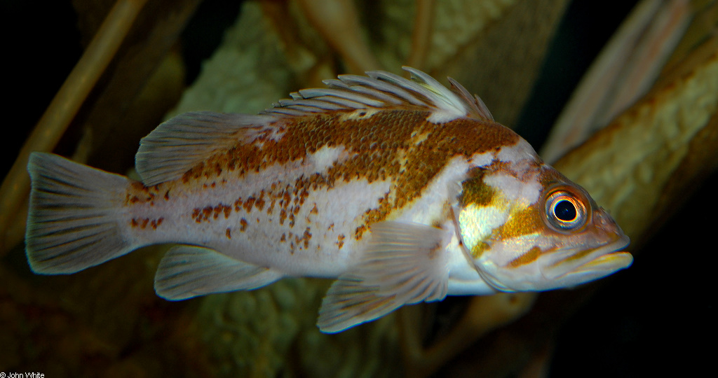
Background
Methods
Results
Next Steps
Question
Conclusions
Levi
Jay Nichols
FishWithJD
John White

Slide 12
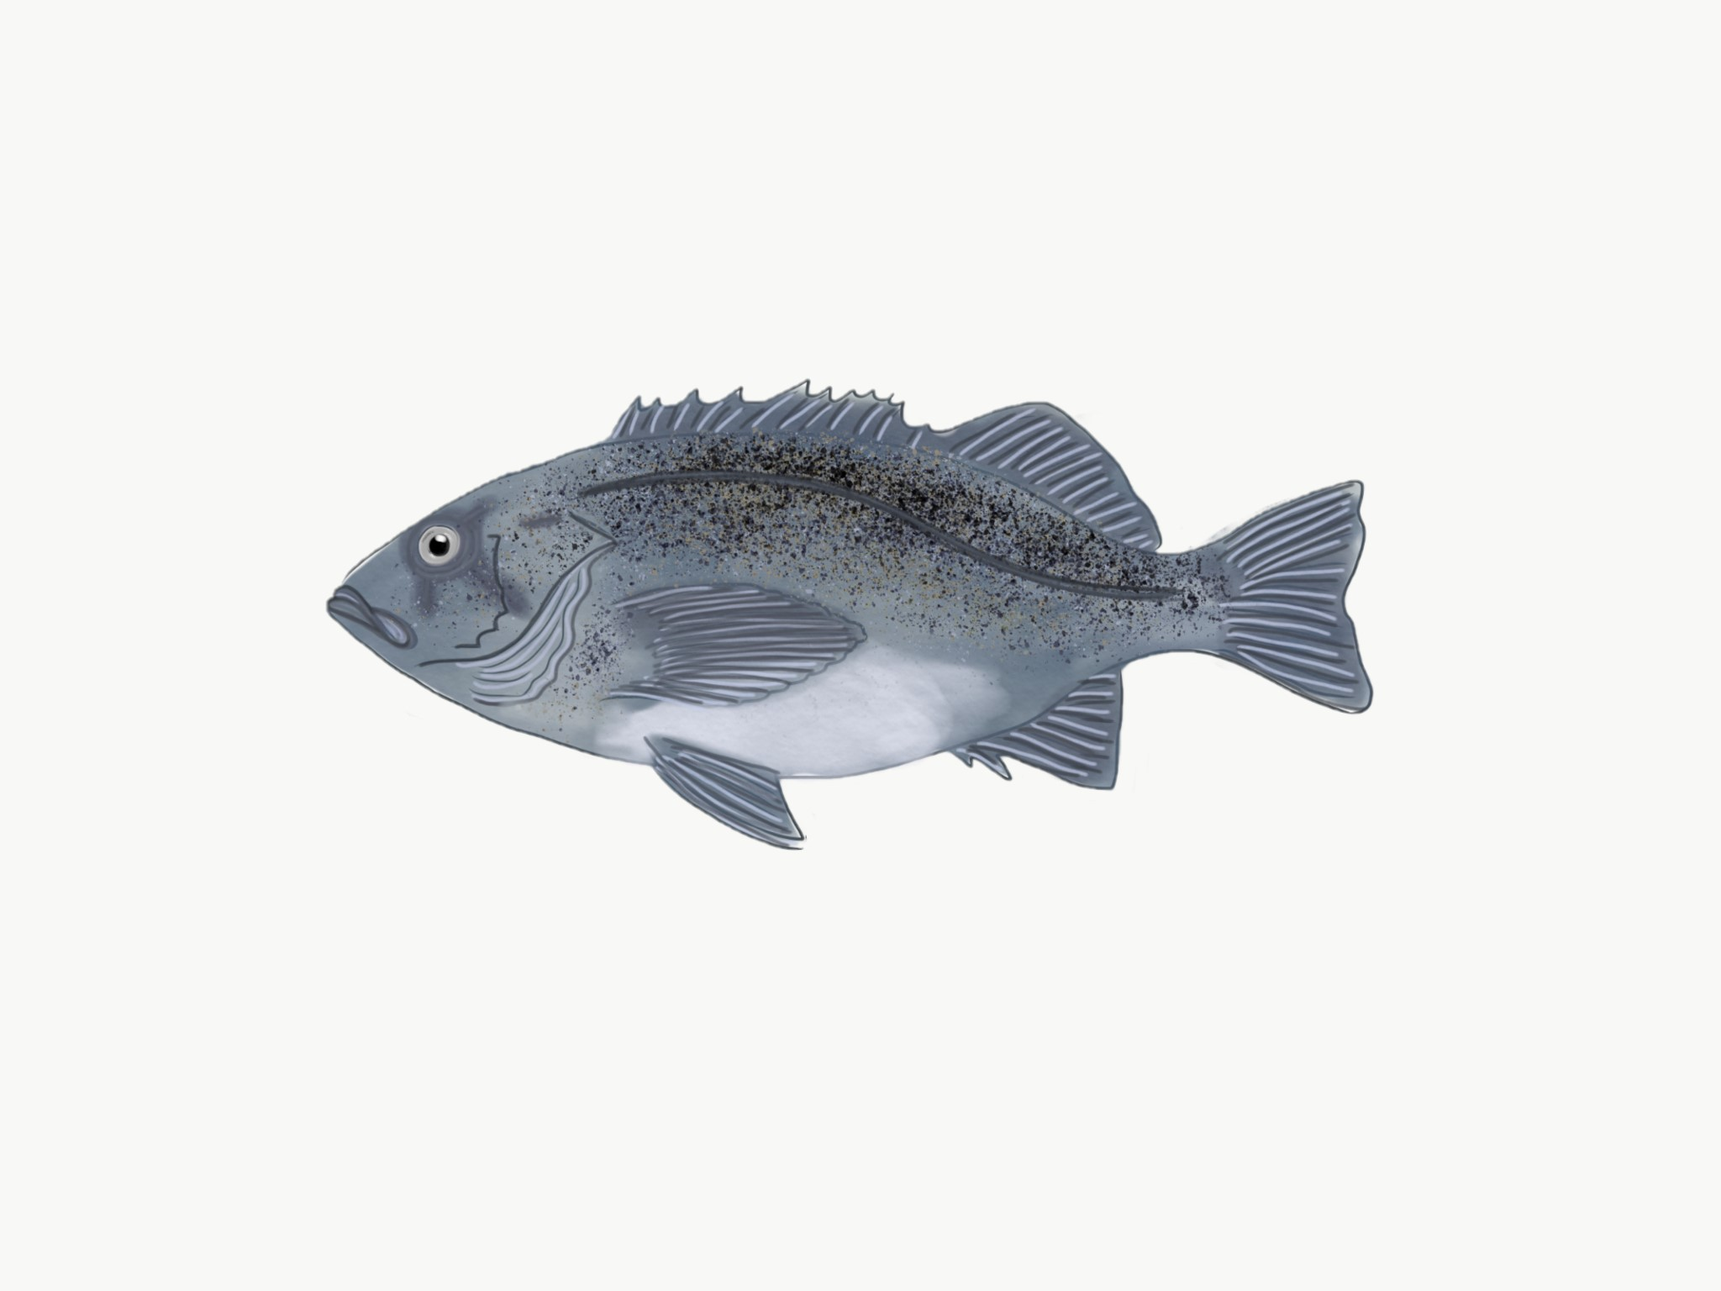
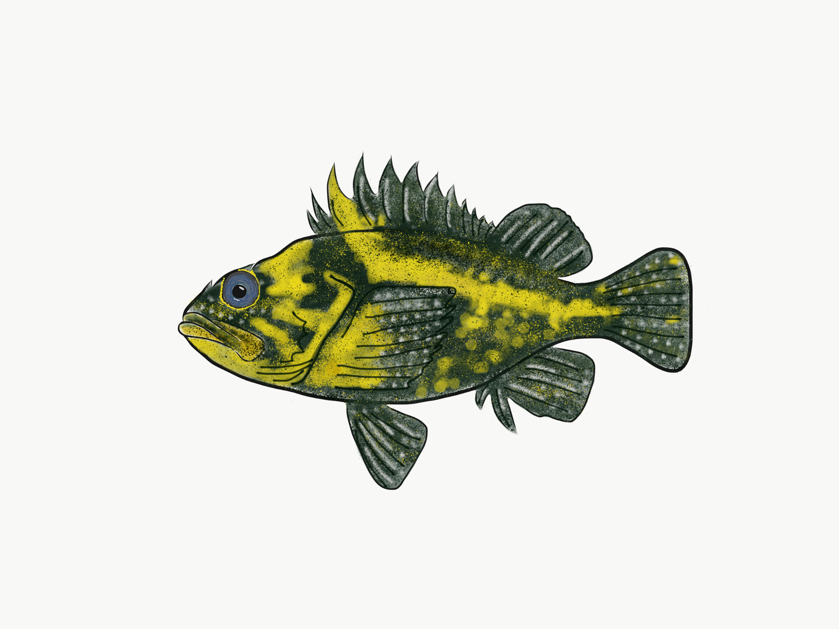
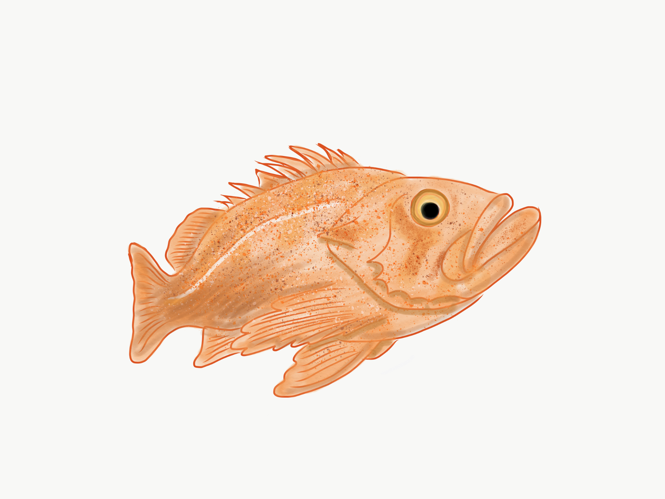
Background
Methods
Results
Next Steps
Question
Conclusions
Replicate base model
Incorporate variability and stochastic recruitment
Explore timescales
Compare control rules
Alex Avila
Alex Avila
Alex Avila

Slide 13
Outcomes
Background
Key Questions
Methods
Hypotheses
Outcomes
Improved methodologies for assessment and management of fisheries populations in marine reserves following implementation
Open-access R model
Alex Avila
Alex Avila
Alex Avila

Slide 14
Key Questions
Background
Key Questions
Methods
Hypotheses
Outcomes
How can we best use information from within reserves to help manage fisheries following reserve implementation?
What are the timescales?
How can we apply control rules?
How do different life history characteristics affect timescales?
Notes:
shorten

Slide 15
Study species: Black rockfish (Sebastes melanops)
Background
Key Questions
Methods
Hypotheses
Outcomes
Black rockfish (Sebastes melanops)
Lingcod (Ophiodon elongatus)
Cabezon (Scorpaenicthys marmoratus)
Copper rockfish (Sebastes caurinus)
Levi
Jay Nichols
FishWithJD
John White
Notes:
Fix citations (see title slide)
All are commercially or recreationally important off the coast of Oregon
Rockfish fishery (mainly recreational) nets state $14 annually, mostly due to black rockfish, increasing since 2015

Slide 16
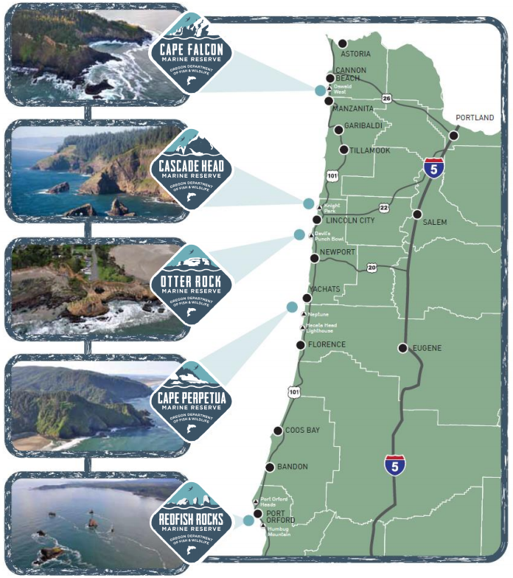
Oregon Marine Reserves
Background
Key Questions
Methods
Hypotheses
Outcomes
ODFW has implemented 5 marine reserves off the coast of OR in last 10 years
Need some way to assess reserves
Promote biodiversity (ergo population persistence)
Minimize costs to communities

Slide 17
Hypotheses
Background
Key Questions
Methods
Hypotheses
Outcomes
Different species with different natural mortalities and growth rates will show different timescales after reserve implementation
Lower natural mortality (M) + higher growth rates (k) = shorter timescales
Incorporation of transient dynamics and stochastic recruitment will lead to improved adaptive management
Lowest M
Highest k
Notes:
shorten

